Slide 1
Model-View Separation Patterns

Slide 2
Model-View Separation Patterns --- Background
Symptom of Poorly designed GUIs:
  Classes with a large and incoherent set of responsibilities:
  Encompass: GUI, Listening to events, domain logic, application logic, etc...
We should separate the concerns.
  Model and view objects
  How should they communicate?

Slide 3
Model View Separation Patterns
Problem:
  How should the non-GUI classes communicate with the GUI classes and vice versa?
Solution:
  Several solutions exist --- each appropriate in a different context.

Slide 4
Model vs. View Objects
Subject or Model
Subject
Interface
XML
xyz…
Observers
Web
Browser
PDA
Cell
Phone
Terminal
View objects

Slide 5
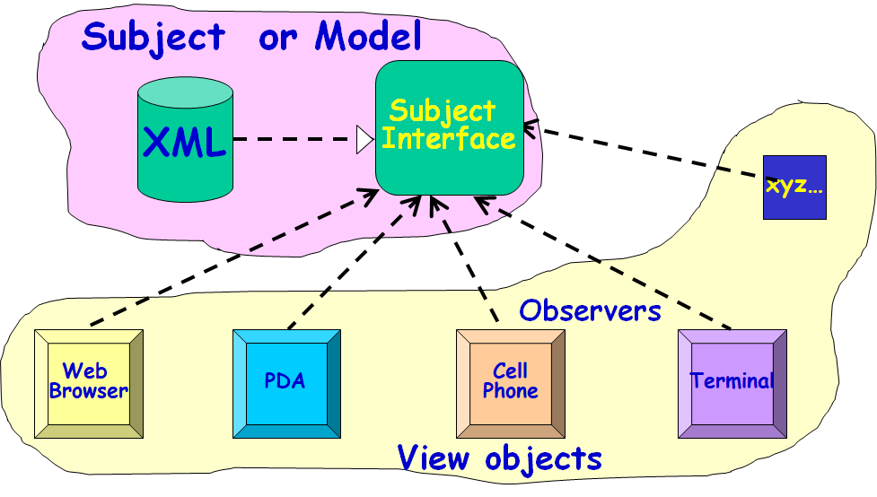
Model View Separation Patterns: Solution Overview
Model objects should not invoke services of view objects…
  Vice-versa is OK, Why?
  View objects are transient…
  Reuse, extension, maintenance are easier.
  A change to a view object does not require change to the model object.

Slide 6
  Solution 1: Pull from Above
Most obvious solution:
  View (boundary) objects directly invoke model objects.
Problems:
  Views can become inconsistent
  View objects do not know when model state changes
Subject or Model
XML
Subject
Interface
xyz…
Web
Browser
PDA
Cell
Phone
Terminal
View Objects

Slide 7
Obvious Solution
Subject or Model
Subject
Interface
XML
xyz…
Web
Browser
PDA
Cell
Phone
Terminal
Observers
Observers
Data is polled by various observers

Slide 8
Contexts in Which Pull from Above Does Not Work
Data changes asynchronously:
  Simulation experiment, stock market alerts, network monitor, Cricket match...
Some clients can change the model:
  A mouse event by a player to make a move.

Slide 9
Model-View Separation Solutions
Pull from above:
  Simple. But does not work when model changes asynchronously
Observer pattern: (GoF)
  Multiple independent observers
Model-View Controller (MVC) Pattern:
  Multiple independent observers
  Multiple independent controllers
Publish-subscribe pattern:
  Large number of observers
  Multiple models elements
  Different observers interested in different classes of events

Slide 10
Observer Pattern: Problem
When a model object changes state asynchronously and is accessed by several view objects:
    How should the interactions between the model and the view objects be structured?
Solution: Define a one-to-many dependency, so that when model changes state, all of its dependents are notified and updated automatically.

Slide 11
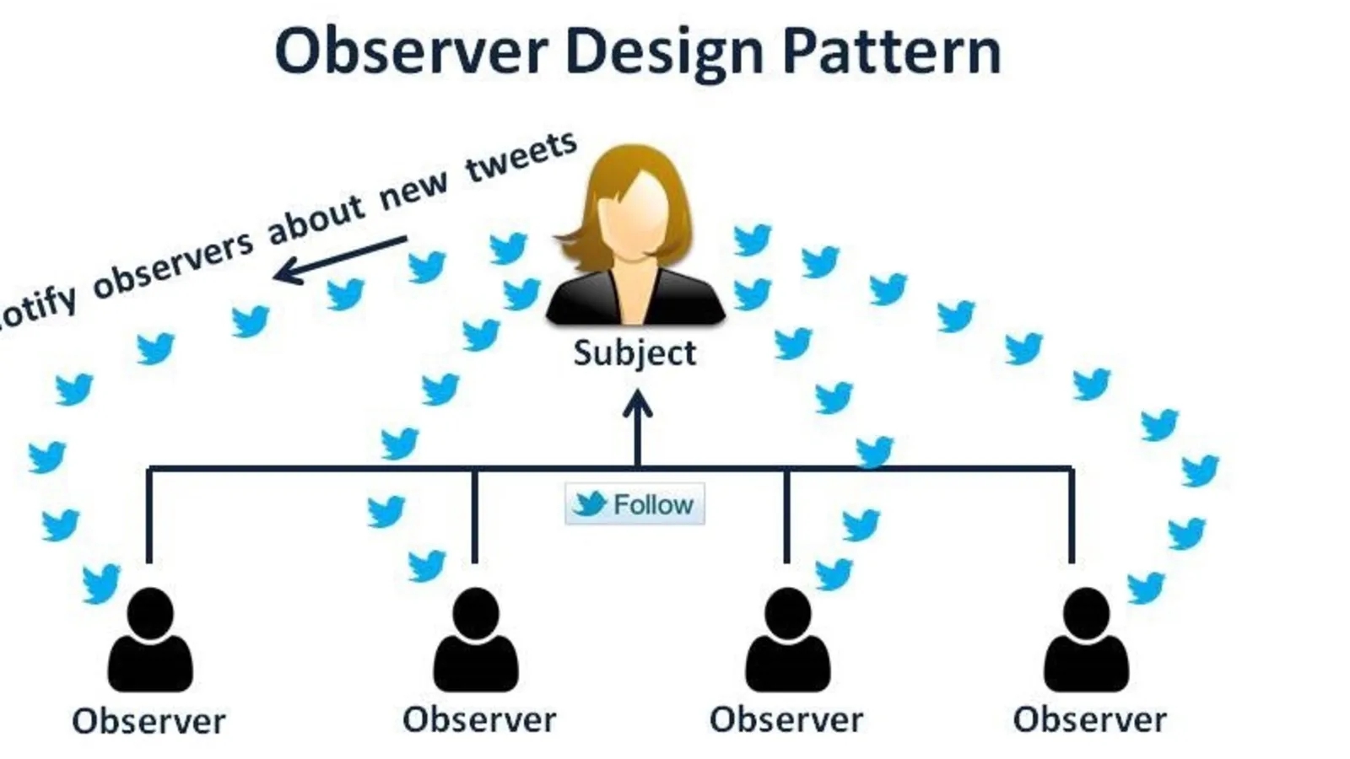
Observer Pattern: Context
There could be many observers:
  Also the number of observers may vary dynamically
  Each observer may react differently to a notification…
Subject (model) should be as much decoupled from the observers as possible:
  Allow observers to change independently of the subject…

Slide 12
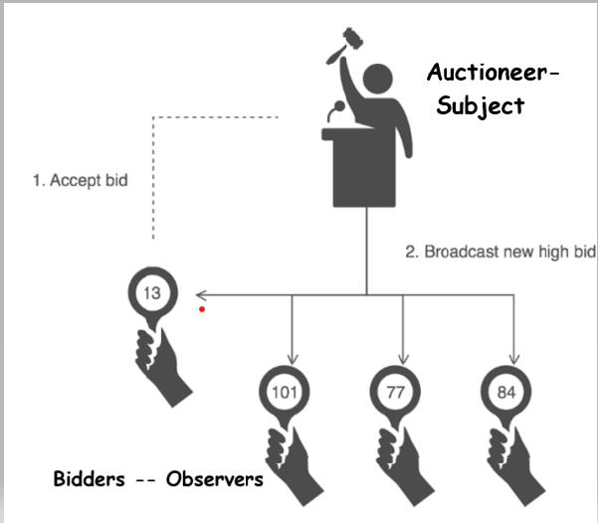
Observer (Non software example)
When an object
changes its state,
all its dependents
are notified.

Slide 13
Example 1: Stock Quote Service
Real time
Market Data
Feed
Stock market
Stock Quotes
A
A
A
B
D
Customer
C
Customer
C
Customer
Customer
Customer
Observers

Slide 14

Example 2: Cricket Match
Internet
Cricinfo Server

Slide 15
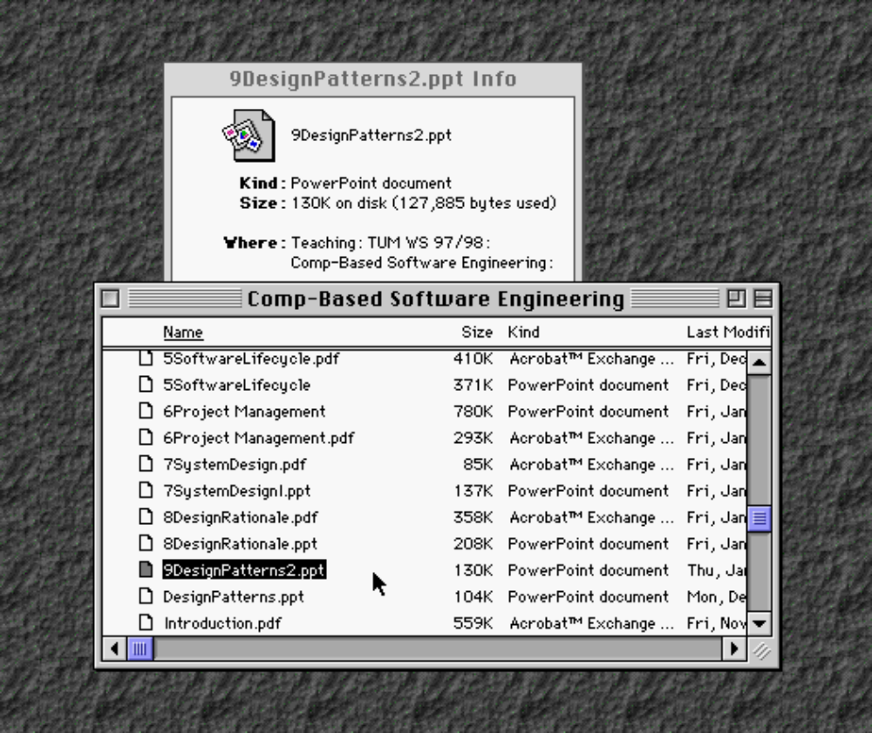
Example 3: File Listing
Observers
Subject
DesignPattern.ppt

Slide 16
Observer Pattern
When observable (model) changes state:
  All dependent objects are notified --- these objects then update themselves.
  Allows for consistency between related objects without tightly coupling the classes.

Slide 17
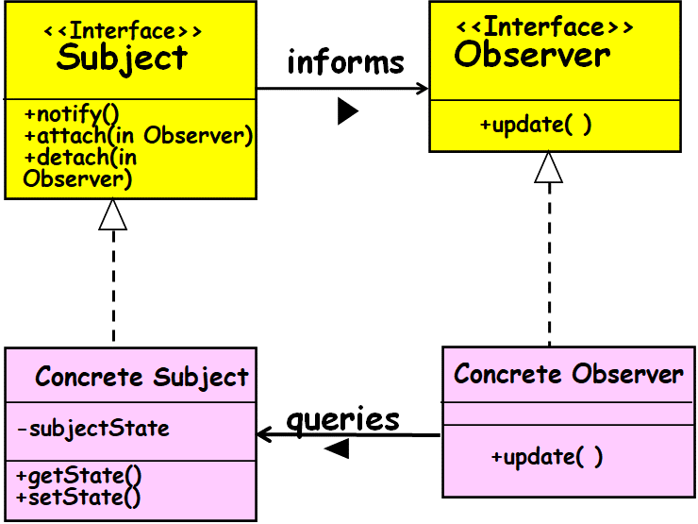
Observer Pattern: Solution
Observers should register themselves with the model object.
  The model object maintains a list of the registered observers.
When a change occurs to a model object:
  Model notifies all registered observers.
  Subsequently, each observer queries the model object to get any specific information about the changes.

Slide 18
Key Players
Subject Interface
  Knows its observers – provides interface for attaching/detaching subjects
Observer Interface
  Defines an interface for notifying the subjects of changes to the object.
ConcreteSubject
  Implements subject interface to send notification to observers when state changes
ConcreteObserver
  Implements Observer interface to keep state consistent with subject

Slide 19
Structure of Observer Pattern
<<Interface>>
Subject
<<Interface>>
Observer
informs
+notify()
+attach(iObserver)
+detach(Observer)
+update( )
for all observer obs
{
obs.update();
}
Concrete Subject
Concrete Observer
queries
-subjectState
+update( )
+getState()
+setState()
observerState = subject.getState();
return subjectState

Slide 20
Observable
<<Interface>>
Observer
informs
+notify()
+addObserver(O)
+detach(Observer)
+update( )
Subject
Concrete Observer
queries
-subjectState
+update( )
+getState()
+setState()

Slide 21
Observer Pattern
Defines a many-to-one dependency between objects:
  When subject changes state, all its dependents are notified and they update themselves.
Effectively decouples the subject from the observer:
  But, the subject has little information about needs of the observer.
  Can result in excessive notifications.

Slide 22
Working of Observer Pattern
  ConcreteSubject notifies its observers:
    Whenever a change makes its state inconsistent with the observers.
After being informed of change:
  A ConcreteObserver queries the subject to reconcile its state with subjects.

Slide 23
Observer Pattern
Subject
<<Interface>>
attach(observer)
detach(observer)
notify()
Observer
<<Interface>>
update()
observers
*
subject
ConcreteObserver
update()
observerState
ConcreteSubject
getState()
setState(newState)
subjectState
The Subject represents the actual state,
  The Observers represent different views of the state.

Slide 24
Animated Sequence diagram
aFile
anInfoView
aListView
Attach()
Attach()
notify()
update()
update()
getState()
“foo”

Slide 25
Activities of Update
ConcreteObserver.Update():
  Check for exceeding some threshold, etc.
  Repaint the user interface
  These are some of the operations that might clutter up a domain class (Subject).

Slide 26
Observer Implementation
A Subject class usually maintains:
  An ArrayList of ids of registered Observers
  Makes it easier when any random object wants to attach or detach

Slide 27
Observer Pattern Implementation in Java
public interface Observer {
public void update(Subject o );
}
Public interface Subject {
public void addObserver(Observer o);
public void removeObserver(Observer o);
public String getState();
public void setState(String state);
}

Slide 28
Subject
Observer
*
attach(Observer)
detach(Observer)
notify()
Update()
for all o in
observers {
o.update( ) }
ConcreteObserver
ConcreteSubject
observerState
update()
subjectState()
getState()
setState()
*
return
subjectState
observerState =
subject.getState( )

Slide 29
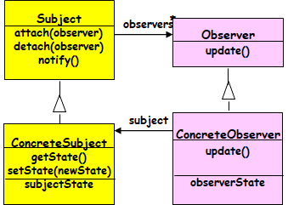
class ConcreteObserver implements Observer {
private String state = "";
public void update(Subject o) {
state = o.getState();
System.out.println("Update received from Subject, state
changed to : " + state);}
}
class ConcreteSubject implements Subject {
private List observers = new ArrayList();
private String state = "";
public String getState() {
return state;}
public void setState(String state) {
this.state = state;
notifyObservers();}

Slide 30
public void addObserver(Observer o) {
observers.add(o);}
public void removeObserver(Observer o) {
observers.remove(o);}
public void notifyObservers() {
Iterator i = observers.iterator();
while (i.hasNext()) {
Observer o = (Observer) i.next();
o.update(this);}
}

